Slide 1


Team 4
Adaptive Chunking for Retrieval-Augmented Generation (RAG)
Members: Justin Hammitt, Andrew Tamalunas, and Aimee Aholou

Slide 2
Problem Statement: Objective
Improve retrieval completeness and answer accuracy while controlling irrelevant content, context size, and query-time processing cost.

Slide 3
Problem Statement: Retrieval-Augmented Generation Chunking
Retrieval-Augmented Generation Chunking
RAG systems retrieve document information and provide it to a language model as context for answering a query.
Fixed chunk boundaries can separate related evidence or include unnecessary surrounding information.
The project investigates constructing query-specific context spans instead of relying only on predefined chunks.

Slide 4
Problem Statement: I/O
Input
Natural-language query, candidate documents, and maximum chunk size (B)
Query terms or anchors identify possible locations of relevant evidence.
Output
One or more query-specific text spans containing the evidence needed to answer the query.

Slide 5
Problem Difficulty and Analysis: Overview
Overview
Current RAG chunking methods use different strategies to identify and retrieve relevant context.
Common limitations include predefined boundaries, query-independent chunking, extra context, and fragmented evidence.
Main Difficulty
Current methods still depend heavily on predefined or query-independent boundaries. Relevant evidence can occur in multiple locations, queries may contain repeated or missing terms, and the available context budget limits how much evidence can be returned.

Slide 6
Problem Difficulty and Analysis: DCR
Dynamic Context-Based Retrieval (DCR)
Expands or contracts existing chunks using marginal information gain.
May require LLM-based semantic validation.
Adds query-time processing and requires threshold calibration.

Slide 7
Problem Difficulty and Analysis: Adaptive Chunking
Adaptive Chunking
Selects a chunking strategy based on document characteristics.
Adaptation occurs before the specific user query is known.

Slide 8
Problem Difficulty and Analysis: DCS
Dynamic Chunking and Selection (DCS)
Creates document-aware segments and uses a question-aware classifier to select them.
Still selects from predefined segments.

Slide 9
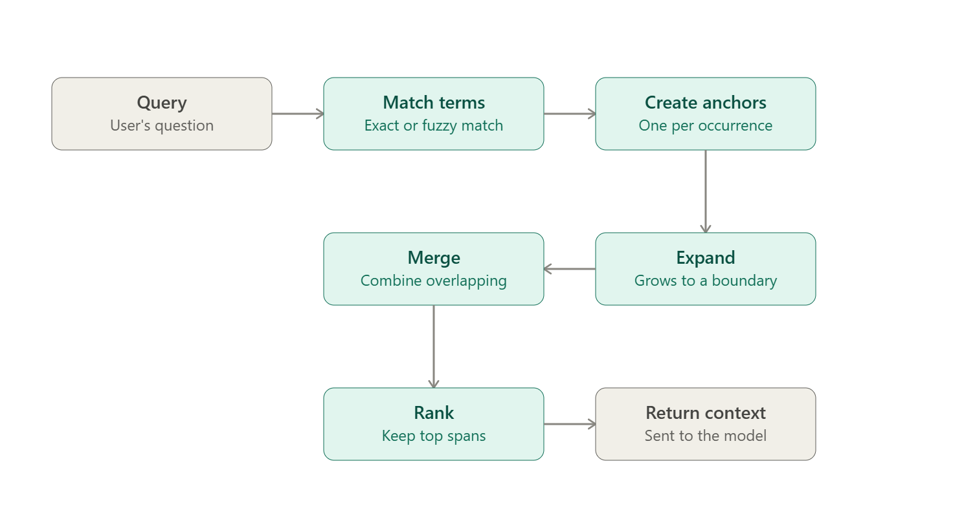
Problem Difficulty Analysis and Proposed Method (cont. algorithm/graphic)
Notes:
Query → Match Terms → Create Anchors → Expand → Merge → Rank → Return Context
Query-Term Identification Normalize the query and locate exact or fuzzy term matches in the document.
Anchor Placement Each matching occurrence becomes an anchor representing a possible evidence location.
Parallel Expansion Each anchor expands left and right through the surrounding text.
Boundary Enforcement Expansion stops at neighboring anchor boundaries, document or section boundaries, or maximum chunk size (B).
Interval Merging Touching or overlapping regions merge when the combined span remains within (B).
Context Selection Candidate spans are ranked and selected until the total context budget is reached.
Limitation
Keyword matching may miss synonyms or paraphrases. Queries with no direct match remain in the evaluation so their effect can be measured.

Slide 10
Simulation Setting: Implementation
Python
Document preprocessing and query-term identification
Anchor placement and interval expansion
Interval merging and candidate ranking
pandas / NumPy for experimental analysis

Slide 11
Simulation Setting: Dataset and Experimental Sizes
SQuAD 1.1
300 questions
10 source articles
60 development questions
240 test questions from separate articles
Methods Compared
Proposed Query-Anchored Expansion
Adaptive Chunking
Fixed-Size Chunking
Maximum Chunk Sizes
128 tokens
256 tokens
512 tokens
Total Context Budgets
512 tokens
1,024 tokens

Slide 12
Simulation Setting (continued - metrics/evaluation)​
Retrieval Quality
Evidence Recall — amount of required supporting evidence retrieved
Retrieval Precision — amount of retrieved context that is relevant evidence
Evidence Completeness — whether all major required evidence is present
Answer Quality
Exact Match
Token-Level F1
Efficiency
Context Size
Retrieval Latency
Preprocessing Cost
Evaluation Controls
All methods use the same:
Documents and questions
Retrieval system
Chunk-ranking rules
Total context budgets
Language model
Prompts and generation settings
Supporting-evidence labels are established before the final comparison, and no-match queries are reported separately.

Slide 13
Milestones and Timeline: Milestones​
Dataset Preparation
Select SQuAD articles and questions
Establish supporting-evidence labels
Separate development and test data
Baseline Implementation
Adaptive Chunking
Fixed-Size Chunking
Proposed Algorithm
Query-term matching
Anchor placement and expansion
Interval merging and context-budget handling
Development Testing
Use the 60-question development set
Establish algorithm parameters and verify behavior
Final Evaluation
Run the 240-question test set
Collect retrieval, answer-quality, and efficiency metrics
Results Analysis
Compare the three methods
Examine chunk-size and context-budget tradeoffs
Analyze no-match cases and algorithm limitations

Slide 14
Milestones and Timeline: Timeline​
Dates | Objective
Sept 21 – Oct 11 | Select SQuAD questions, establish evidence labels, split development/test data, and implement the baseline chunking methods.
Oct 12 – Oct 24 | Implement query-term matching, anchor placement, expansion, interval merging, and context-budget handling.
Oct 25 – Nov 22 | Tune parameters on the 60-question development set, then evaluate all methods on the 240-question test set.
Nov 23 – Dec 7 | Compare methods, analyze tradeoffs and limitations, prepare final slides/demo, and submit the report and code.

Slide 15
References
Sreenivasan Mohandas and Tiasha Majumdar. Think before You Fetch: Smarter Retrieval for Smarter LLMs with Enhanced Table Understanding and Long-Form Reasoning. Proceedings of the 18th International Conference on Agents and Artificial Intelligence (ICAART 2026), Volume 2, pp. 1166–1174. SCITEPRESS. 2026. 142320.pdf
Paulo Roberto de Moura Júnior, Jean Lelong, and Annabelle Blangero. Adaptive Chunking: Optimizing Chunking-Method Selection for RAG. Proceedings of the Fifteenth Language Resources and Evaluation Conference (LREC), Palma de Mallorca, Spain. 2026. [2603.25333] Adaptive Chunking: Optimizing Chunking-Method Selection for RAG
Boheng Sheng, Jiacheng Yao, Meicong Zhang, and Guoxiu He. Dynamic Chunking and Selection for Reading Comprehension of Ultra-Long Context in Large Language Models. Proceedings of the 63rd Annual Meeting of the Association for Computational Linguistics (ACL), Volume 1: Long Papers. 2025. 2025.acl-long.1538.pdf
Tong Chen, Hongwei Wang, Sihao Chen, Wenhao Yu, Kaixin Ma, Xinran Zhao, Hongming Zhang, and Dong Yu. Dense X Retrieval: What Retrieval Granularity Should We Use? Proceedings of the 2024 Conference on Empirical Methods in Natural Language Processing (EMNLP), Miami, Florida, USA. 2024.Dense X Retrieval: What Retrieval Granularity Should We Use? - ACL Anthology

